Slide 1
Bus Ticket
Reservation System
Team Name: IIUC_INCOGNITOS
Team Member:
Md. Shafayet Jamil (C181019)
Rahim Uddin Rafin (C181008)
Mahin Mahtab (C181010)

Slide 2
Introduction
Online Bus Ticket Reservation System is Windows based application that works within centralized network. The software program “Online Bus Reservation System” provides bus transportation system, a facility to reserved seats and different types of enquiry which need an instant and quick reservation. This software is built for manage and computerize the traditional database, ticket booking etc.

Slide 3
Diagram
User
Select Route
Check Availability
Select Bus
Admin
Select Seat
Input Passenger Information
Add Place
Add Operator
Add Route
Confirm Reservation

Slide 4
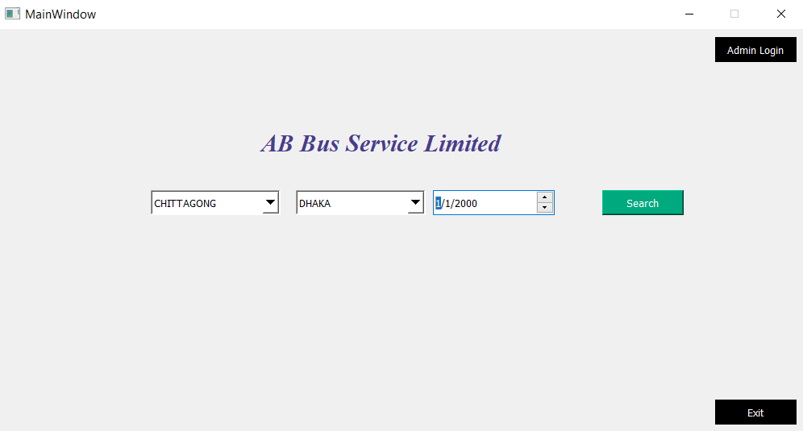
Main Window

Slide 5
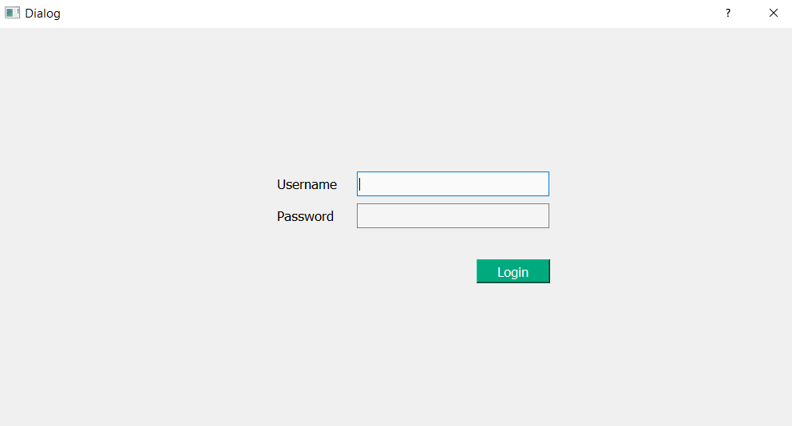
Admin Login
*Username: 1 | Password: 1

Slide 6
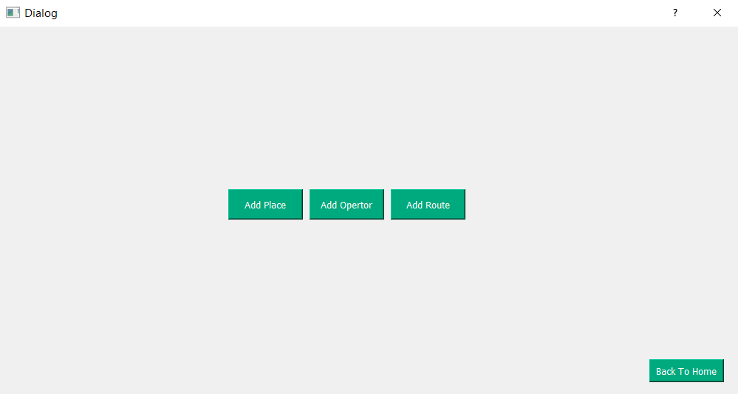
Admin Panel

Slide 7
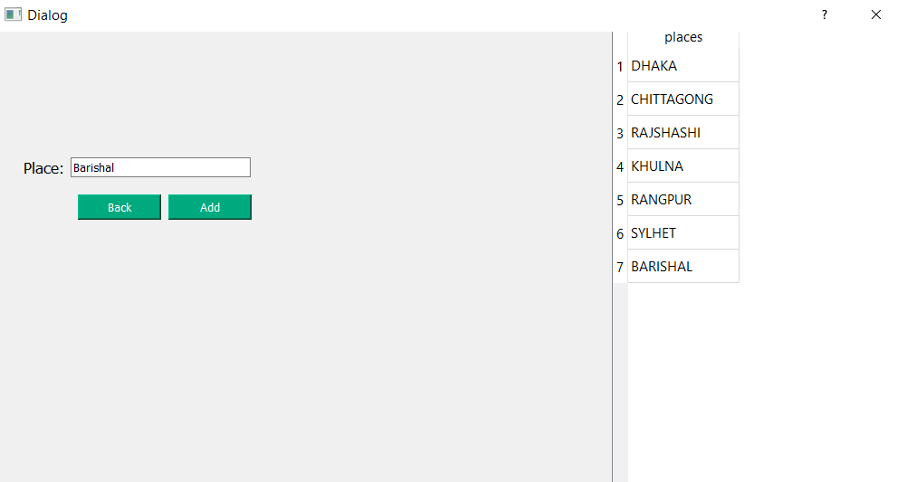
Add Place | Admin can add places here

Slide 8
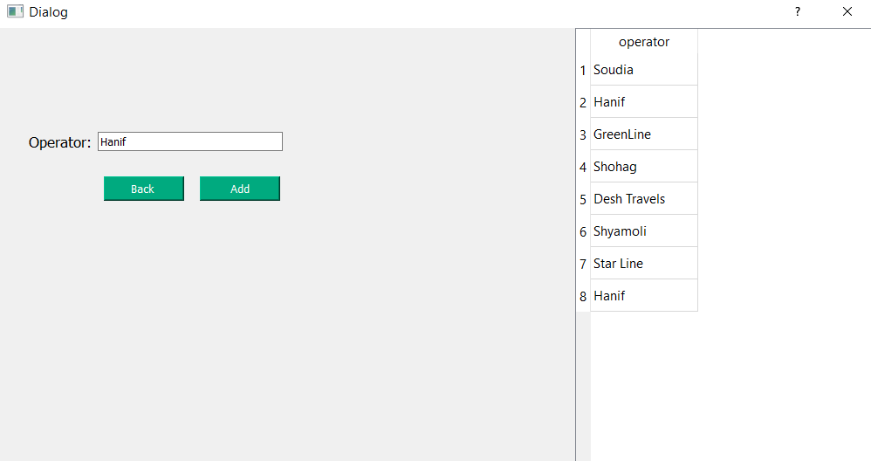
Add Operator | Admin can add Bus Operator here

Slide 9
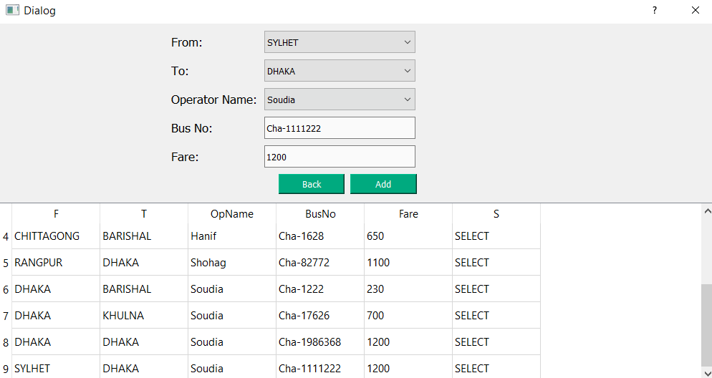
Add Route | Admin can add Bus route here

Slide 10
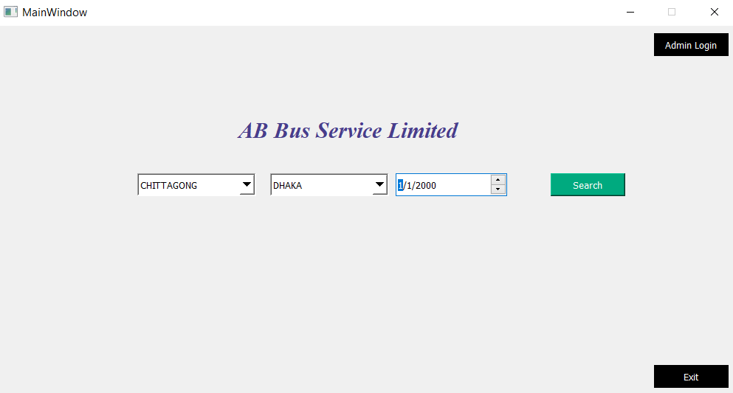
Main Window | User can select bus route for search

Slide 11
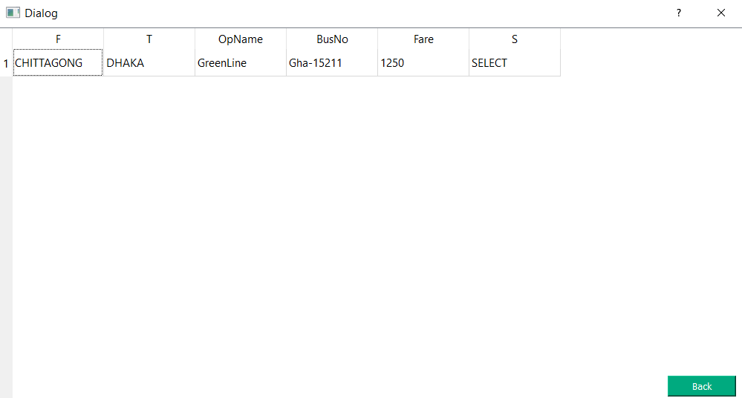
Show Available Bus | User can select bus here

Slide 12
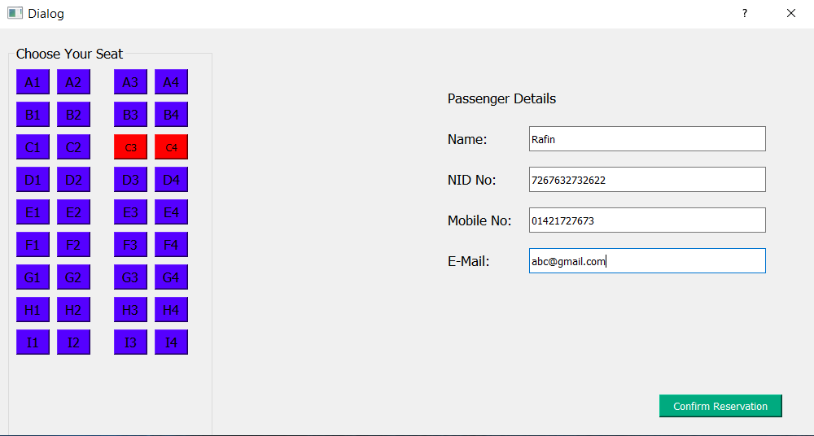
Seat Select | User can select seat and give information for seat reservation

Slide 13
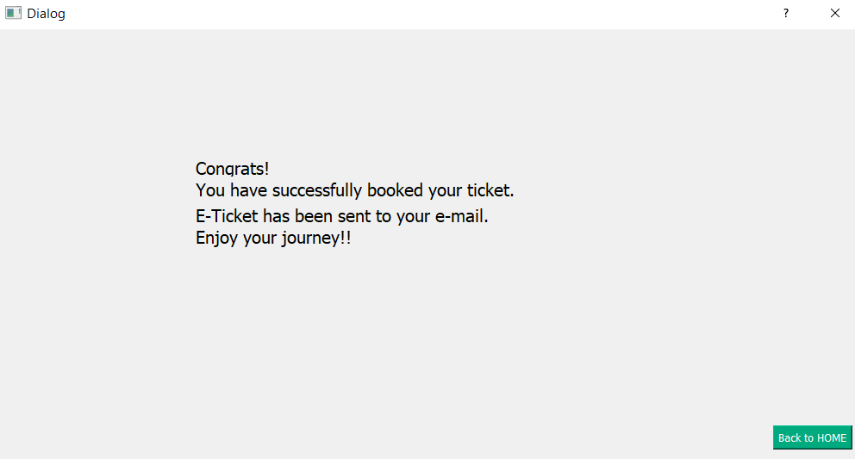
Confirm Message | User have a confirmation message after seat reservation

